Slide 1
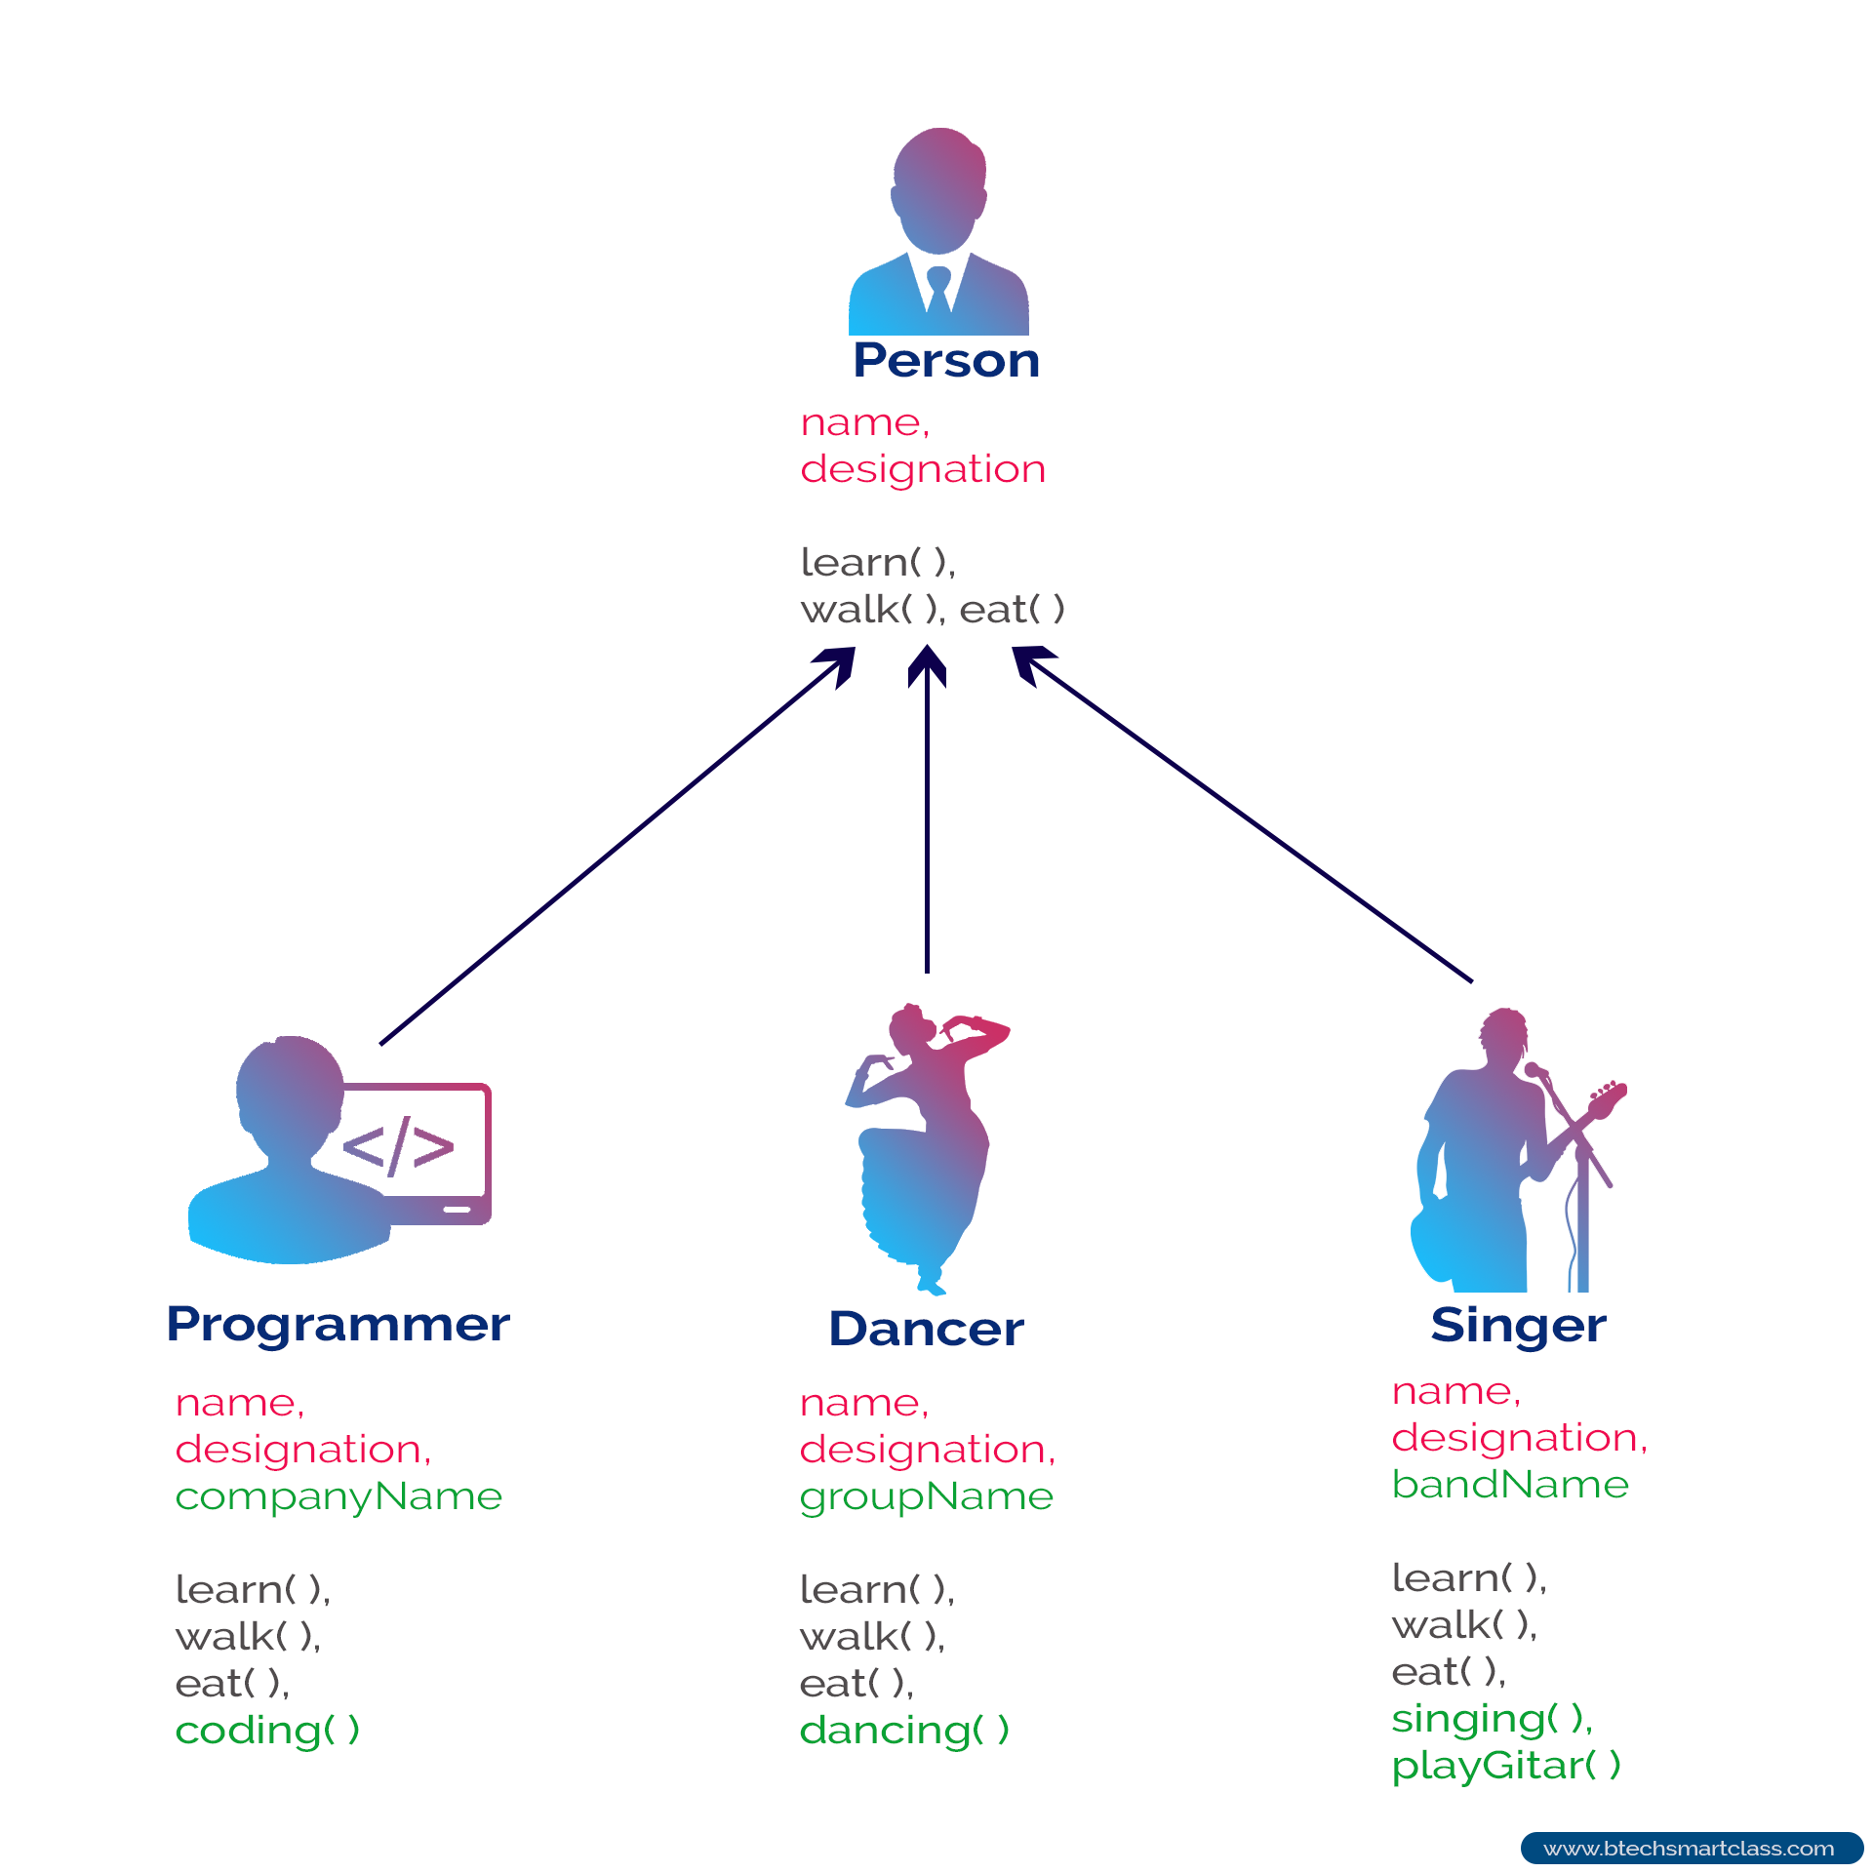
Object Oriented Thinking
And Inheritance

Slide 2
Today
Check In
GE02 - Make sure tech doc is up to date and that you completed the labs from class.
Goals
Differentiate between method overloading and method overriding and explain when each is appropriate.
Apply inheritance to extend classes and reuse code efficiently.
Set up: The usual

Slide 3
Quiz
Open Tech Doc
M01 L02 Objects and Classes - 20, 22 - 25, 29, 30
M01 L03 Strings Methods 1D Arrays and Memory - 11, 12, 17, 24, 27-29
M01 L04 2D Arrays and Static variables 3, 7, 10, 15, 18
M01 L05 Problem Solving with Classes -
CS2050 Agile Software Development_.pptx - 10,
M01 L06 Array of Objects .pptx - wasn’t on quiz

Slide 4

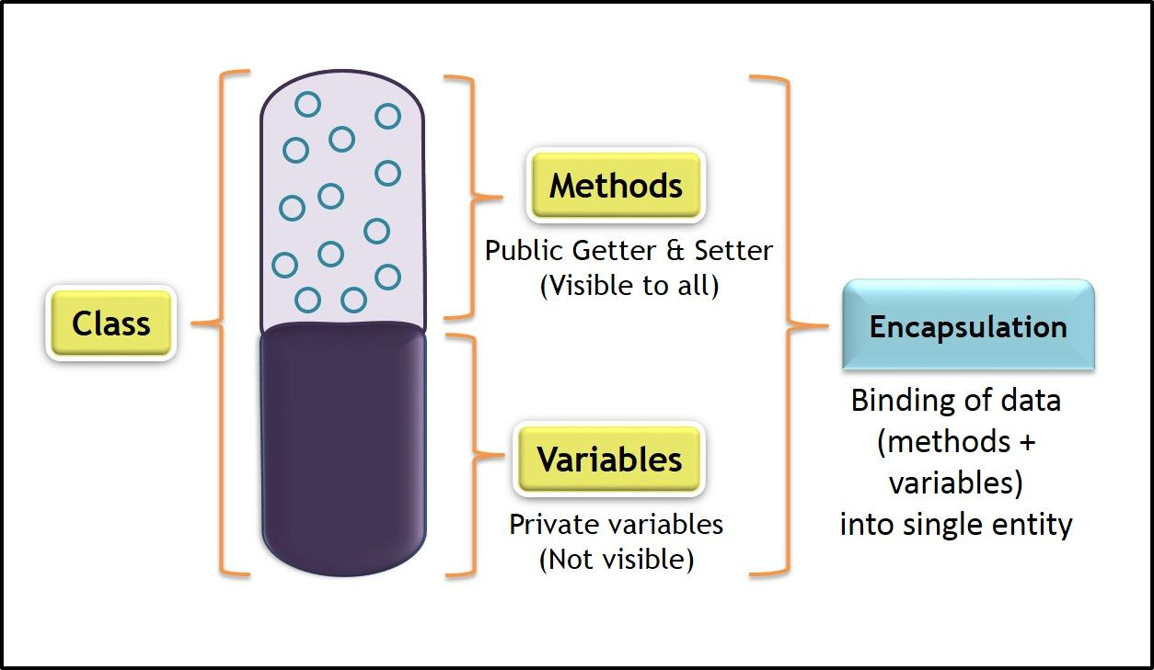
Solving Problems Using Object- Oriented Paradigm
The object-oriented programming paradigm has the following core concepts that we will be learning over the next lectures.
Encapsulation
Inheritance
Polymorphism
Abstraction
Encapsulation in Java

Slide 5

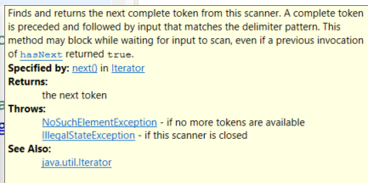
Class Abstraction and Encapsulation
Class abstraction means to separate class implementation from the use of the class. The creator of the class provides a description of the class and let the user know how the class can be used. The user of the class does not need to know how the class is implemented. The detail of implementation is encapsulated and hidden from the user.
You've experienced this with the predefined classes you have used such as Java Scanner class
You used a method on the class to perform a task such as
You had no idea or cared about how that method was implemented

Slide 6
Class Relationships
Up to now, we’ve seen how to define classes like Book and Library. But in real life, objects don’t live alone — they work together.
First we’ll look at three kinds of relationships in Object-Oriented Programming: association, aggregation, and composition.
Relationships between classes
Association
Aggregation
Composition

Slide 7
Association
Association: One class knows about another. Think of “uses-a” (or “knows-a”) relationship.
A relationship that describes an activity between two classes where there is a lose connection meaning they exist independently.
A student borrows a library book. They are connected, but not owned by each other. class Library {
public void checkout(Book book) {
// Library uses Book temporarily
}
}
Association is the weakest relationship where there is just a reference, not ownership.

Slide 8
Aggregation
Aggregation: One class has another, but the parts can exist independently. Think of a weak “has-a” relationship
Example in life: A library has books, but books can also exist outside the library or move to another library. In code: class Library {
private Book[] books; // created outside, added in
}
This is what our Library has Book uses. We create the Book in main, then put it in the Library. If the Library goes away, the Book still exists.

Slide 9
Composition
Composition: A strong “owns-a” relationship. If the container goes way, the parts go away too. Think of a strong “has-a” relationship
Example in life: A house is made of rooms. If the house is demolished, the rooms no longer exist. In code: class Library {
private Book[] books;
public Library(int size) {
books = new Book[size];
books[0] = new Book("Unmasking AI", "Joy Buolamwini", 2023);
}
}
Here the Library creates the Books itself — so it owns them completely.

Slide 10
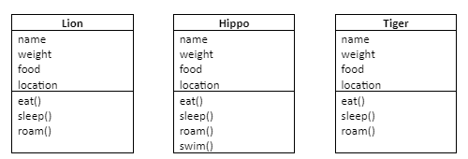
Design a Zoo
Assume you have to write a program for a zoo that contains different animals
Each animal will be represented by an object
New and different kinds of animals may be added later so we want the code to be extendable
We need classes that are blueprints for the different animals - Lions, Hippos, Tigers etc.
Here are some UML diagrams for a few of the animals we want to model:
What do you notice about the data fields and members?

Slide 11
Designing to Avoid Repetition (DRY)
If we implement each of these classes as shown then there will be repeated code in each of the objects
Repeating code is never a good thing in programming, because it is hard to:
Maintain repeated code
Debug code when it is repeated all over the place
What's a programmer to do?
Avoid redundancy by using inheritance!

Slide 12
Inheritance
Designing with inheritance means
You place common code in a class – both the state and behavior
This class becomes a superclass
You have the other classes "extend" the superclass
These classes become subclasses
By extending the superclass, these classes inherit from the superclass
This is called a "IS-A" relationship

Slide 13
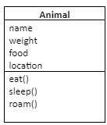

Inheritance Basics
Pull out the common bits. Place these common pieces into their own class "Animal"
Make the Animal the superclass (parent). Link the other classes to the Animal class
Animal is the superclass (parent)
Lion inherits from Animal
Hippo inherits from Animal
Tiger inherits from Animal
This means: if the Animal class contains the functionality, then the subclass AUTOMATICALLY gets the same functionality
Lion, Hippo, Tiger are the subclasses (children)

Slide 14
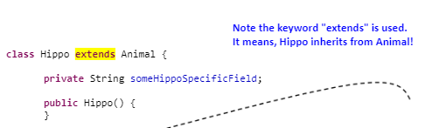
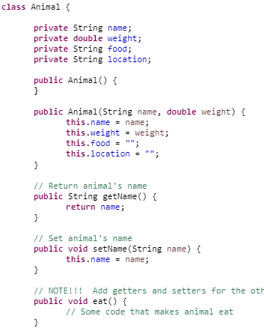
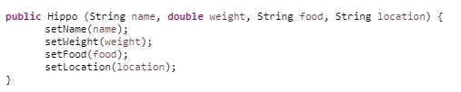

Code
Subclass Hippo extend Superclass Animal
Contains the common properties and behaviors for any Animal
Added specific hippo data field
If private can’t access outside of Animal
Relationship:
Hippo “Is A” Animal
Inherits all the public methods in Animal
Added specific hippo method

Slide 15
Inheritance “Is- A” relationship
Inheritance
When the definition of a class is based on an existing class
Superclass
Contains the common properties and behaviors
Called the parent class
Subclass
A class that extends another class directly or indirectly
Inherits accessible data fields (instance variables)
In Java, all classes are subclasses of the Object class.
Called the child class, extended class, derived class
Method overriding
When a subclass modifies the implementation of a method defined in its superclass (parent)

Slide 16
Superclass Constructor
When the definition of a class is based on an existing class (called the superclass)
Means the class that is inheriting (subclass) can use accessible date fields and methods from superclass.
Constructors are NOT inherited by the subclass
This means you cannot directly call a superclass constructor
But superclass constructor can be invoked explicitly or implicitly.
To access explicitly - use the super keyword
To access implicitly (automatically) - If keyword super is not explicitly used, the superclass's default constructer (no arguments) is automatically invoked.

Slide 17
Subclass Overview
A subclass inherits methods from a superclass (parent). This means the subclass can use superclass accessible methods
You can add new properties that are specific to your subclass
You can add new methods that are specific to you subclass
You can override methods in the superclass
Sometimes it is necessary for the subclass to modify the implementation of a method defined in the superclass. This is referred to as method overriding.

Slide 18
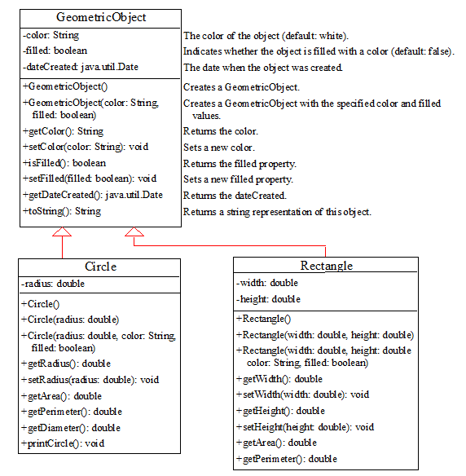
Rectangle, Circle and Square
Download TestShapesInheritance.java and add to M03 Project in Eclipse
The inheritance relationship => IS-A relationship
CircleFromSimpleGeomtricShape (child subclass) inherits from SimpleGeometricShape (parent superclass)
Superclass Contains the common properties and behaviors. Subclass inherits from a superclass
Inherits accessible data fields (instance variables)
“Is A”

Slide 19
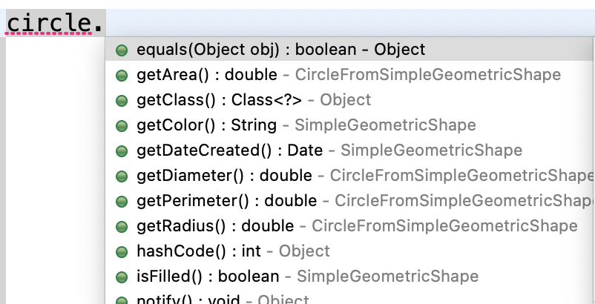
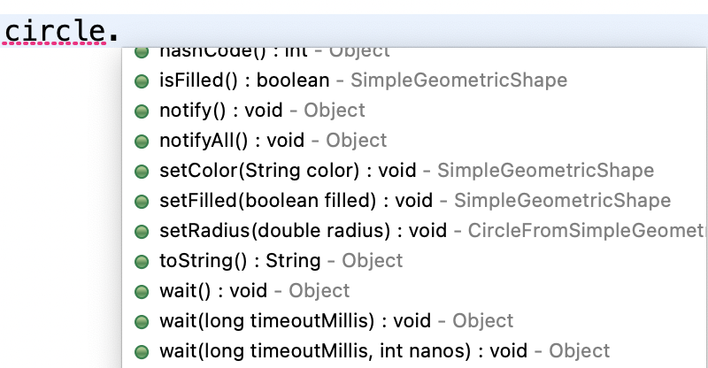
Explore Code
CircleFromSimpleGeometricShape circle =
new CircleFromSimpleGeometricShape(1);
System.out.println("circle toString: " + circle.toString());
System.out.println("The color is " + circle.getColor());
System.out.printf("The radius is %.2f \n", circle.getRadius());
System.out.printf("The area is %.2f \n", circle.getArea());
System.out.printf("The diameter is %.2f \n", circle.getDiameter());
Identify superclass and subclass
Construct a circle2 object given the radius, color and filled
Put a breakpoint in every constructor in the superclass and subclass. What order when constructing circle and circle2
What methods are not defined in either class that are being called?

Slide 20
Encapsulation and Inheritance
SimpleGeometricShape
- color : String
- filled : boolean
- dateCreated : Date
+ getColor() : String
+ setColor(String) : void
+ isFilled() : boolean
+ setFilled(boolean) : void
+ getDateCreated() : Date
CircleFromSimpleGeometricShape
- radius : double
+ getRadius() : double
+ setRadius(double) : void
+ getArea() : double
+ getDiameter() : double
+ getPerimeter() : double
Superclass: SimpleGeometricShape
Subclass: CircleFromSimpleGeometricShape extends SimpleGeometricShape
Notice color, filled, and dateCreated are private.
You cannot write in the subclass: this.color = "red"; // ❌ error
Instead, the subclass must use the public setters: setColor("red");
setFilled(true);

Slide 21
Constructors
Every constructor in the child calls a parent constructor first.
In your CircleFromSimpleGeometricShape(double radius) constructor:
public CircleFromSimpleGeometricShape(double radius) {
this.radius = radius;
// super() is called here automatically
}
Why does this work? Because SimpleGeometricShape has a default constructor: public SimpleGeometricShape() {
dateCreated = new java.util.Date();
}
If that constructor didn’t exist, the compiler would complain.
If the parent has no no-arg constructor, you must explicitly call super(arguments) in the child.

Slide 22
Implicit and Explicit Constructor Calls
When you write a subclass constructor like:
public CircleFromSimpleGeometricShape(double radius) {
this.radius = radius;
}
Java implicitly inserts a call to the parent’s no-args constructor at the very top:
public CircleFromSimpleGeometricShape(double radius) {
super(); // <-- compiler adds this automatically
this.radius = radius;
}
Implicit call: If you don’t write super(...) yourself, Java automatically calls the parent’s default (no-args) constructor.
Explicit call: If the parent has no default constructor, you must write super(arguments...) explicitly to match one of the parent’s constructors.

Slide 23
Main step by step
CircleFromSimpleGeometricShape circle = new CircleFromSimpleGeometricShape(1);
Memory space for a CircleFromSimpleGeometricShape is allocated.
The SimpleGeometricShape() constructor runs first (so dateCreated is set).
Then the CircleFromSimpleGeometricShape(double radius) constructor runs (so radius = 1).
When you print:
System.out.println("The color is " + circle.getColor());
You’re calling the inherited getter from the parent.
Default color is "white" because that was set in the parent.

Slide 24
Summary
Inheritance lets us reuse code (Circle inherits color, filled, and dateCreated from SimpleGeometricShape).
Encapsulation still applies (Circle can’t touch color directly, must use getters/setters).
Constructors chain up (Child must create parent first; if no parent default constructor exists, you must explicitly call one with super(...))

Slide 25

Object Class
At the top of the Java hierarchy is a class called Object - more specifically - java.lang.Object
This means every class in Java inherits from the Object class
Even if inheritance is not specified - the class is a subclass of Object
The Object class has some methods that are useful - the first is the toString() method

Slide 26
toString() Method
toString from
Method available on all objects
Method that returns a string that describes an object
Default implementation returns a string that contains
Class name of which the object is an instance
at sign - @
Number representing the object
Not very useful
public class AnimalTester {
public static void main(String[] args) {
// Create a Lion
Lion maxTheLion = new Lion();
System.out.println (maxTheLion.toString());
}
}
Displays Default implementation of toString provides this
Lion@1667a232
Unique id of object

Slide 27
To String
Where is the toString method defined?
System.out.println("circle1 toString: " + circle.toString());
circle toString: CircleFromSimpleGeometricShape@6d06d69c
All classes inherit from the Object class. See which methods can be called for an instance of a circle that were not in the circle class.

Slide 28
Override To String Method
System.out.println("circle1 toString: " + circle.toString());
circle toString: CircleFromSimpleGeometricShape@6d06d69c
Add the following method to the SimpleGeometricShape class
What do you think will happen? Debug to find out.
@Override
public String toString() {
System.out.println("In SimpleGeometricShape toString method ");
return "created on " + dateCreated + "\ncolor: " + color +
" and filled: " + filled;
}

Slide 29
Inheritance and Overriding
When a method is defined in a subclass (child) that matches a method defined in superclass(parent), this is called method overriding
The subclass (child) method must match method signature and return type of method in superclass (parent)
The @Override annotation indicates that the child class method is over-writing its base class method. Use annotation since it makes your code more understandable and helps avoid mistakes.
Says annotated method is required to override a method in the superclass.
If it does not override superclass method, then a compiler error occurs.
Where is there overloading? What is the difference between overriding and overloading?
@Override
public String toString() {
System.out.println("In SimpleGeometricShape toString method ");
return "created on " + dateCreated + "\ncolor: " + color +
" and filled: " + filled;
}

Slide 30
Override To String Method
System.out.println("circle1 toString: " + circle.toString());
Add the following method to the CricleFromSimpleGeometricShape class.
What do you think will happen? Debug to find out.
@Override
public String toString() {
System.out.println("In CircleFromSimpleGeometricShape toString method ");
return super.toString() + " radius: " + radius;
}

Slide 31
Superclass Methods
Superclass Methods
The super keyword can also be used to access a method in the superclass (parent)
This is NOT necessary to do in most cases
It IS NECESSARY when you override a superclass (parent) method in the subclass (child)
If you want call overridden method in subclass, leave super off.
If you want to call the method in the super class, need to use super keyword.
@Override
public String toString() {
System.out.println("In CircleFromSimpleGeometricShape toString method ");
return super.toString() + " radius: " + radius;
}
A special keyword used within a subclass (child) to refer to the superclass. Used in subclass (child) to invoke its parent's methods

Slide 32
Overriding
When a method is defined in a subclass (child) that matches a method defined in superclass(parent)
Remember a subclass inherits all accessible methods from superclass (parent)
Sometimes it might be necessary to change the implementation of the superclass method.
This is called method overriding
The subclass (child) method must match signature and return type of method in superclass (parent)
Method Signature - combination of the method name and formal parameter list

Slide 33
Overriding Methods in the Superclass
Only accessible instance methods can be overridden
This means if a method is private in the superclass (parent) and the subclass (child) contains a method with the same signature as the private method in the superclass, these two methods are distinct methods - not related.
Static methods can be inherited but not overridden.
Static methods belong to the class - so cannot be overridden
If you create a static method in subclass (child) with the same signature as the static method in the superclass (parent), what happens?
It is not an error
The superclass static method is hidden
Can invoke by using the superclass name in the following fashion
SuperClassName.staticMethodName();

Slide 34
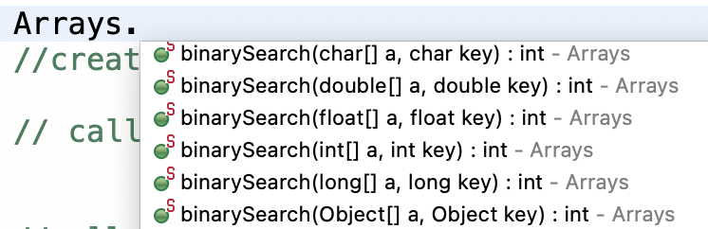
Overloading Methods
Method-overloading-in-java - Method overloading in Java is the feature that enables defining several methods in a class having the same name but with different parameters lists.

Slide 35
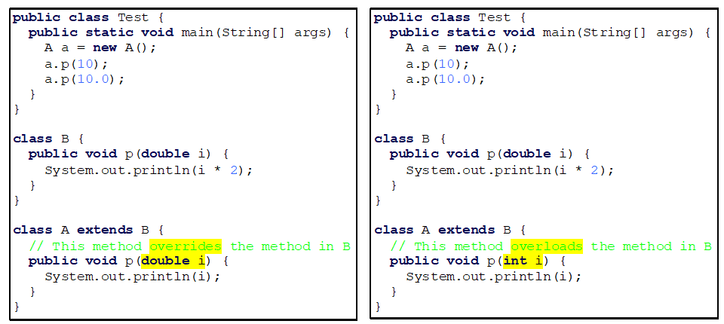
Overriding vs. Overloading
Block on left: Method "p" in class A overrides method "p" in class B because A inherits from B and Method "p" in A matches in signature and return type method "p" in B.
Test class both call the "p" method in class A and print 10.0
Block on right: Method "p" in class A overloads method "p" in class B because Method "p" in A has different formal parameters than method "p" in B. Class A has 2 methods called "p" - one takes an int the other a double
a.p(10) displays 10 and a.p(10.0) displays 20.0
Both a.p call p method in Class A and print 10.0
a.p(10) calls class A method for int
a.p(10.0) calls class A method for double.
Override
Overload

Slide 36
Preparation
See canvas

